Slide 1
Quiz App
Summary

Slide 2
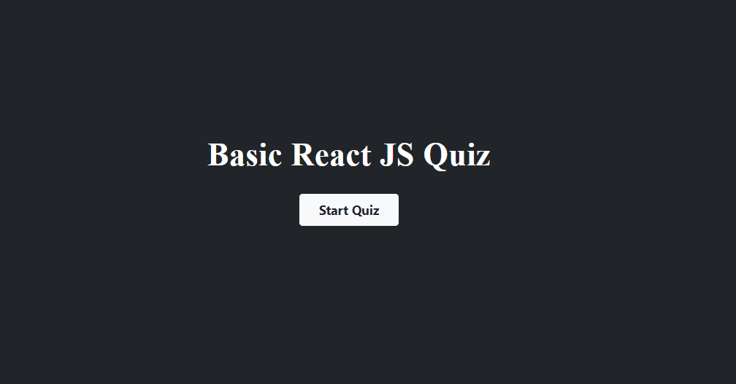
Contents of this template
You can delete this slide when you’re done editing the presentation
Fonts | To view this template correctly in PowerPoint, download and install the fonts we used
Used and alternative resources | An assortment of graphic resources that are suitable for use in this presentation
Thanks slide | You must keep it so that proper credits for our design are given
Colors | All the colors used in this presentation
Icons and infographic resources | These can be used in the template, and their size and color can be edited
Editable presentation theme | You can edit the master slides easily. For more info, click here
For more info: Slidesgo | Blog | FAQs
You can visit our sister projects: Freepik | Flaticon | Storyset | Wepik | Videvo

Slide 3
On Clicking the start quiz button quiz is started

Slide 4
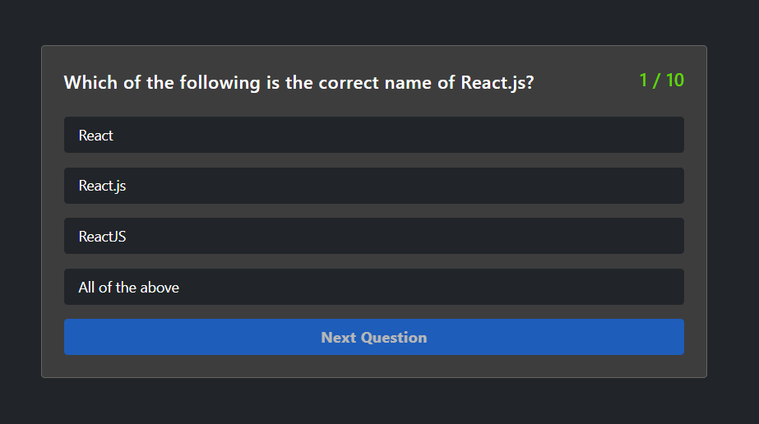
On Clicking the start quiz button quiz is started

Slide 5
There are total 10 questions with 4 options in each question

Slide 6
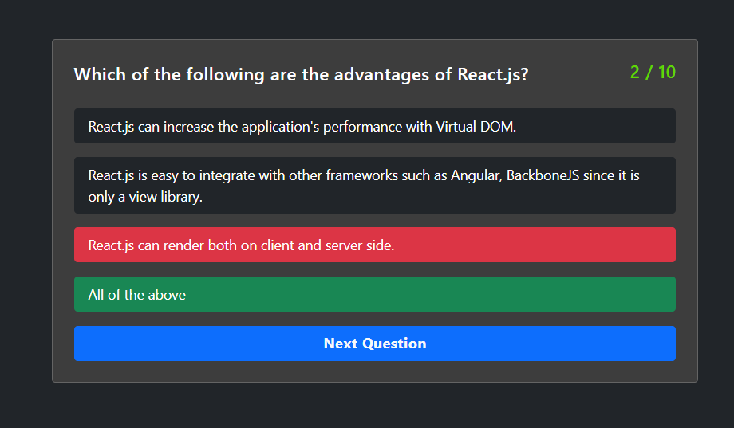
On Clicking the start quiz button quiz is started

Slide 7
If user selects wrong option then choosen option will be marked red and correct option will be highlighted with green color.

Slide 8
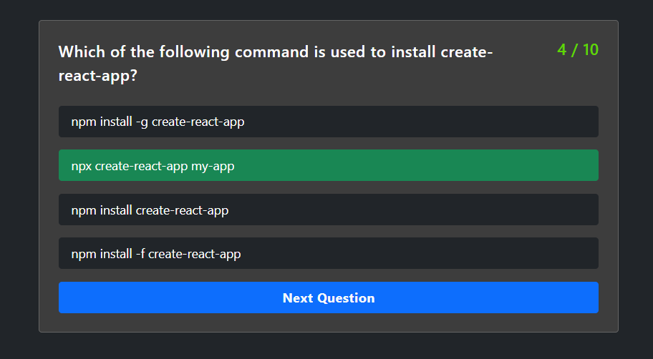
On Clicking the start quiz button quiz is started

Slide 9
On clicking right option , option will be highlighted with green color. 5 marks will be awarded on each answer.

Slide 10
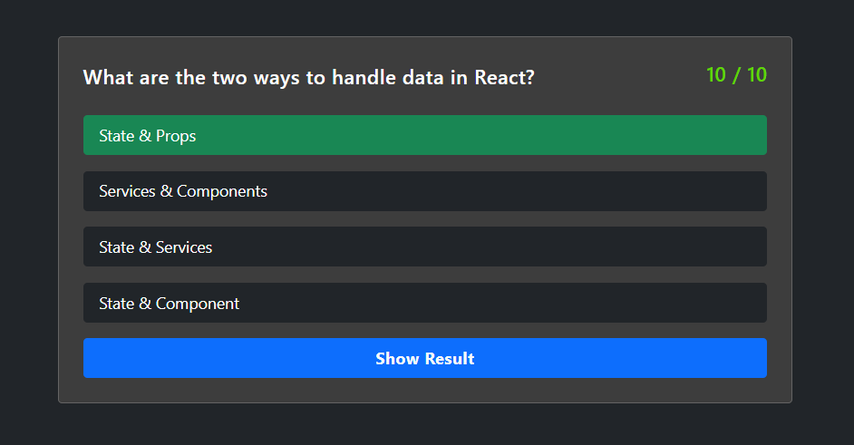
On Clicking the start quiz button quiz is started

Slide 11
On last question there will be button for submit quiz.

Slide 12
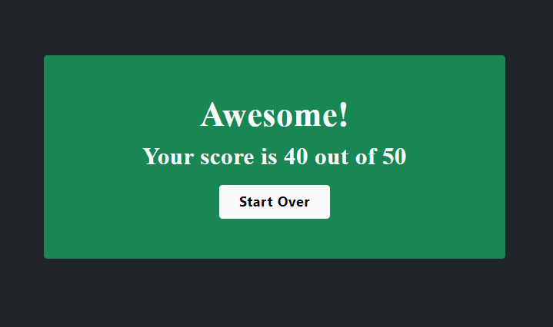
On Clicking the start quiz button quiz is started

Slide 13
After submitting , total marks will be shown with grade as Awesome if done good or Oops if marks is low.

